Slide 1
Deferred REndering
ChenHan Tsai

Slide 2
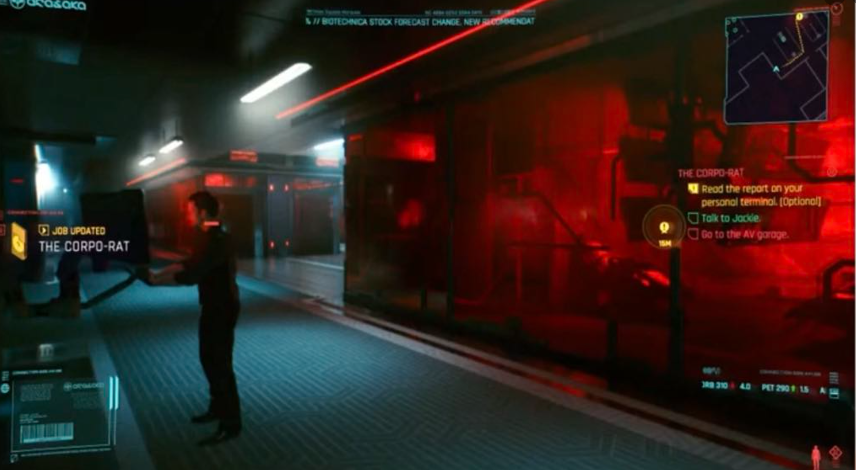
Why deferred rendering?

Slide 3
What is Deferred rendering
 | Forward rendering | Deferred rendering
Year | 1970s | Mid 2000
Algorithm | simple | complex
Lights calculation EXPENSIVE | Each object need to calculate the lights, every pixel have the chance to be calculated many times, O(objects x Lights). | Lights only calculate once per pixel after all objects in one screen space
Memory usage | lower | More, depend on your resolution and data type
Transparent ability | Native support, just draw back to the front and blend | Need hybrid because every pixel is calculated one time, so need to use forward rendering at the end

Slide 4
What is Deferred rendering
Forward rendering
Vertex shader
Rasterization
Pixel shader
Frame buffer
Input assembly
Input assembly
Rasterization
Pixel shader
Vertex shader
G-Buffer
Deferred rendering
Step 1. Geometry pass
Step 2. Light pass
Vertex shader
Rasterization
Pixel shader
Screen space quad
Lighting calculation using G-buffer textures
Frame buffer

Slide 5
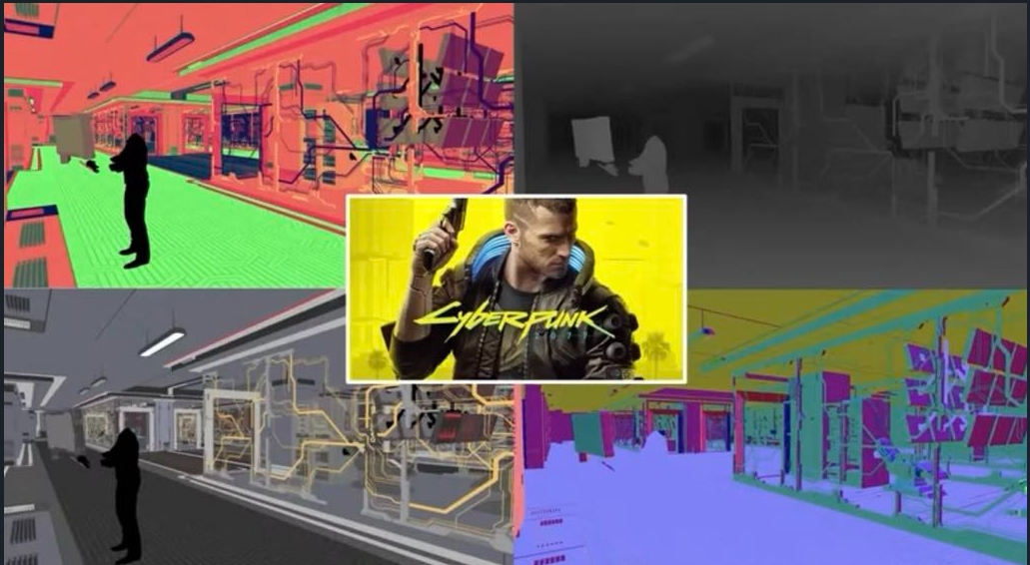
What is G-Buffer

Slide 6
Setup G-Buffer
C++/CPU side
Setup offscreen framebuffer and texture
Create Texture
VkImage
Offscreen frame buffer
VkRenderPass
RecordCommandBuffer
VkImageView
VkDeviceMemory
VkBuffer
VkFrameBuffer
VkCommandBufferBeginInfo
VkRenderPassBeginInfo
Draw…etc
vkCmdEndRenderPass
vkEndCommandBuffer
Descriptor setup

Slide 7
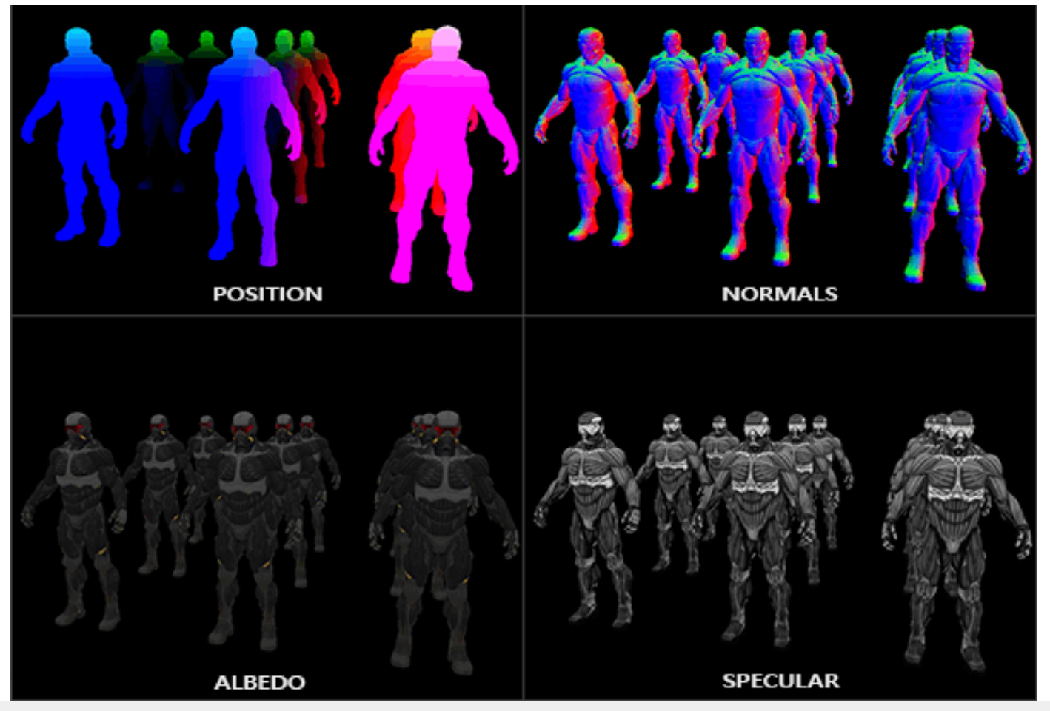
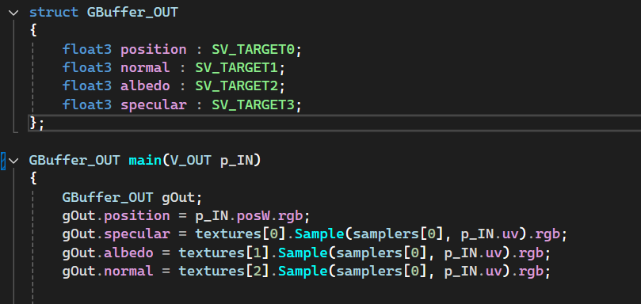
Setup G-Buffer
Shader side
Position: World position.
Calculate the direction from view
Normal/Albedo/Specular/Others: Lighting calculation
SV_TARGET0
SV_TARGET1
SV_TARGET2
SV_TARGET3
https://alitaunbreakablewarrior.github.io/deferred-shading.html
Questions: How many SV_TARGET we can bind?

Slide 8
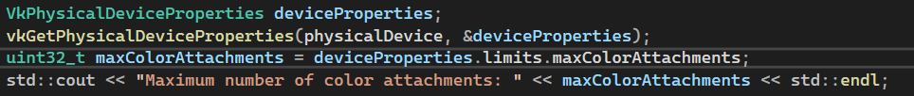
What is G-Buffer
Questions: How many SV_TARGET we can bind?
It’s hardware dependent, but there are a bunch of stuff can query

Slide 9
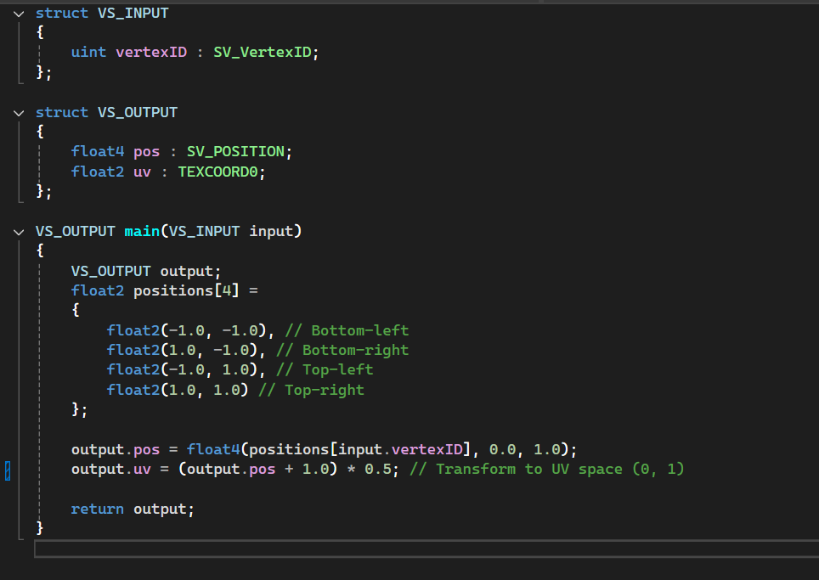
Light pass
Screen space vertex shader
Draw a quad in ndc space
SV_VertexID from 0
Assign corresponding uv
Is there another way ?

Slide 10
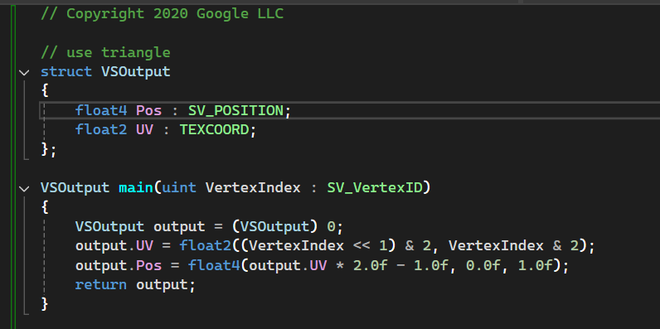
Light pass
Draw a triangle in ndc space,
but out of range ( -1. 1)
GPU cull the range out of ndc space
SV_VertexID : 2
UV: (0, 2)
Pos: (-1, 3)
SV_VertexID : 0
UV: (0, 0)
Pos: (-1, -1)
SV_VertexID : 1
UV: (2, 0)
Pos: (3, -1)

Slide 11
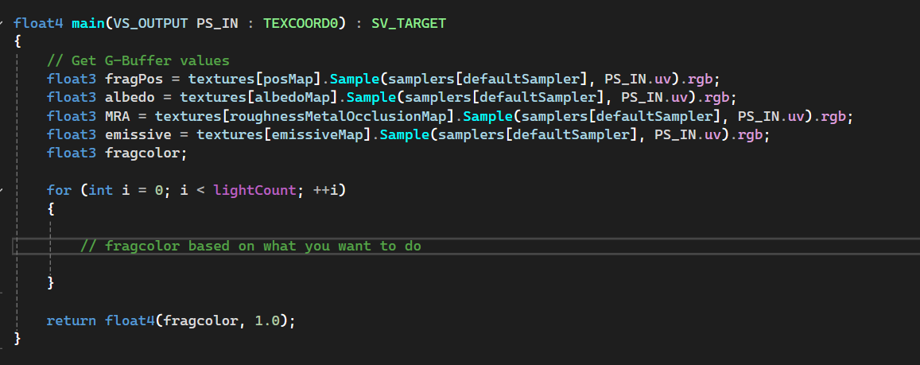
Light pass
Pixel shader
Combined with bindless texture

Slide 12
What’s next?
Deferred rendering is good for screen space post effects, example: SSAO(Screen space ambient occlusion, screen space reflection, bloom effect, motion blur… etc
There are other rendering technology, below are some examples
Forward plus rendering
https://github.com/bcrusco/Forward-Plus-Renderer?tab=readme-ov-file
Tile base deferred rendering
https://developer.apple.com/documentation/metal/tailor-your-apps-for-apple-gpus-and-tile-based-deferred-rendering
Ray tracing

Slide 13
Summary
Deferred rendering is good for a lot of lights case.
Geometry pass – render the geometry and store the information on textures
Light pass – each pixel calculate one time for all the lights
Pros: Improves performance on multiple lights cases, also good for post effect
Cons: More memory usage, transparent need extra rendering

